Slide 1
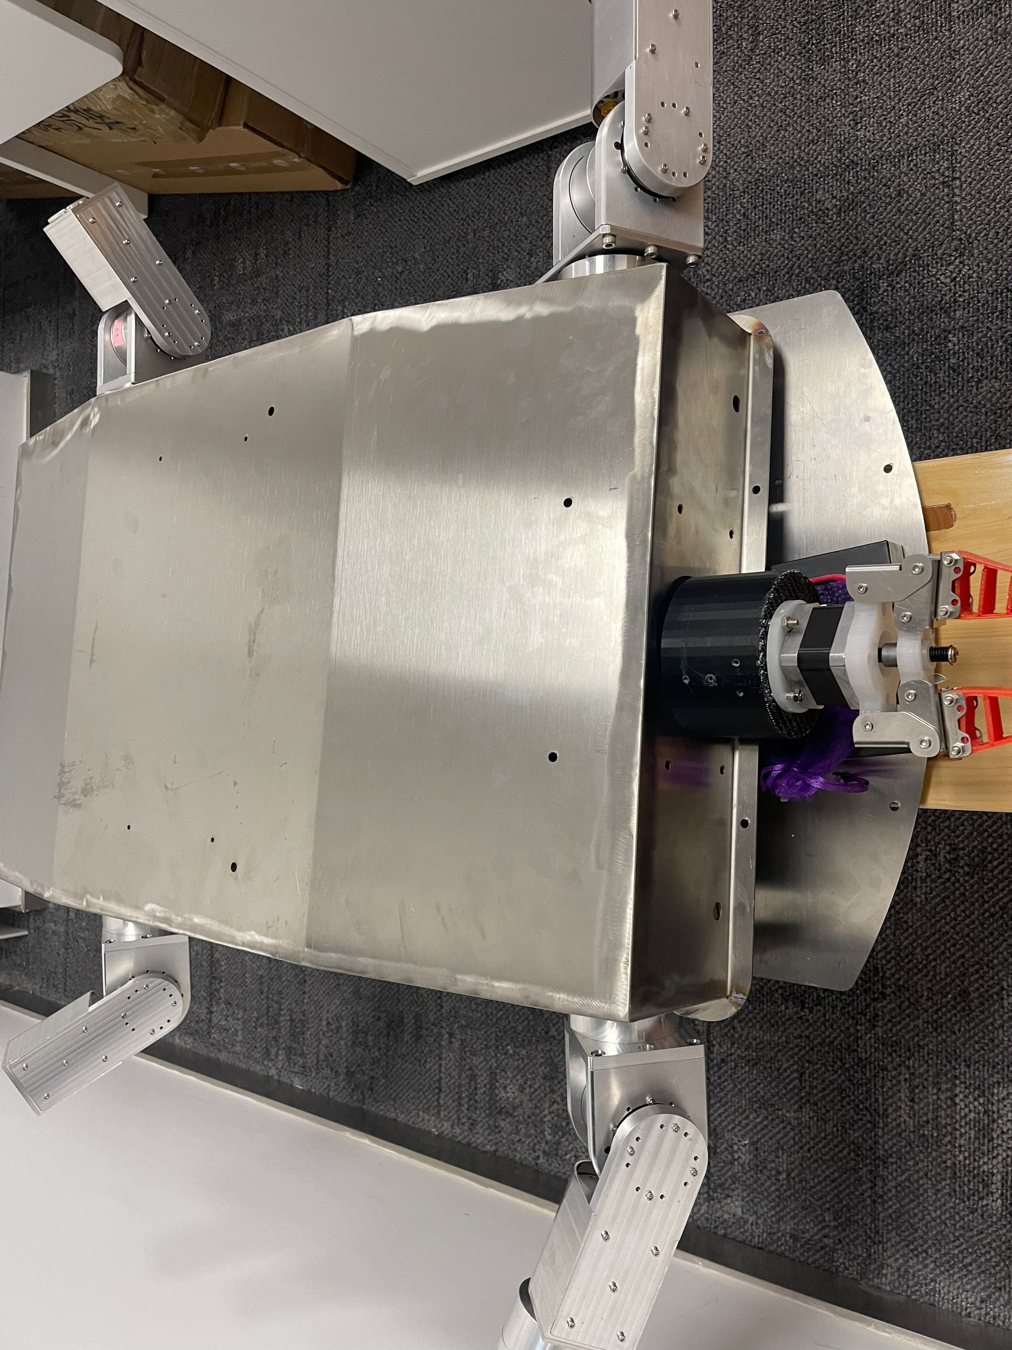
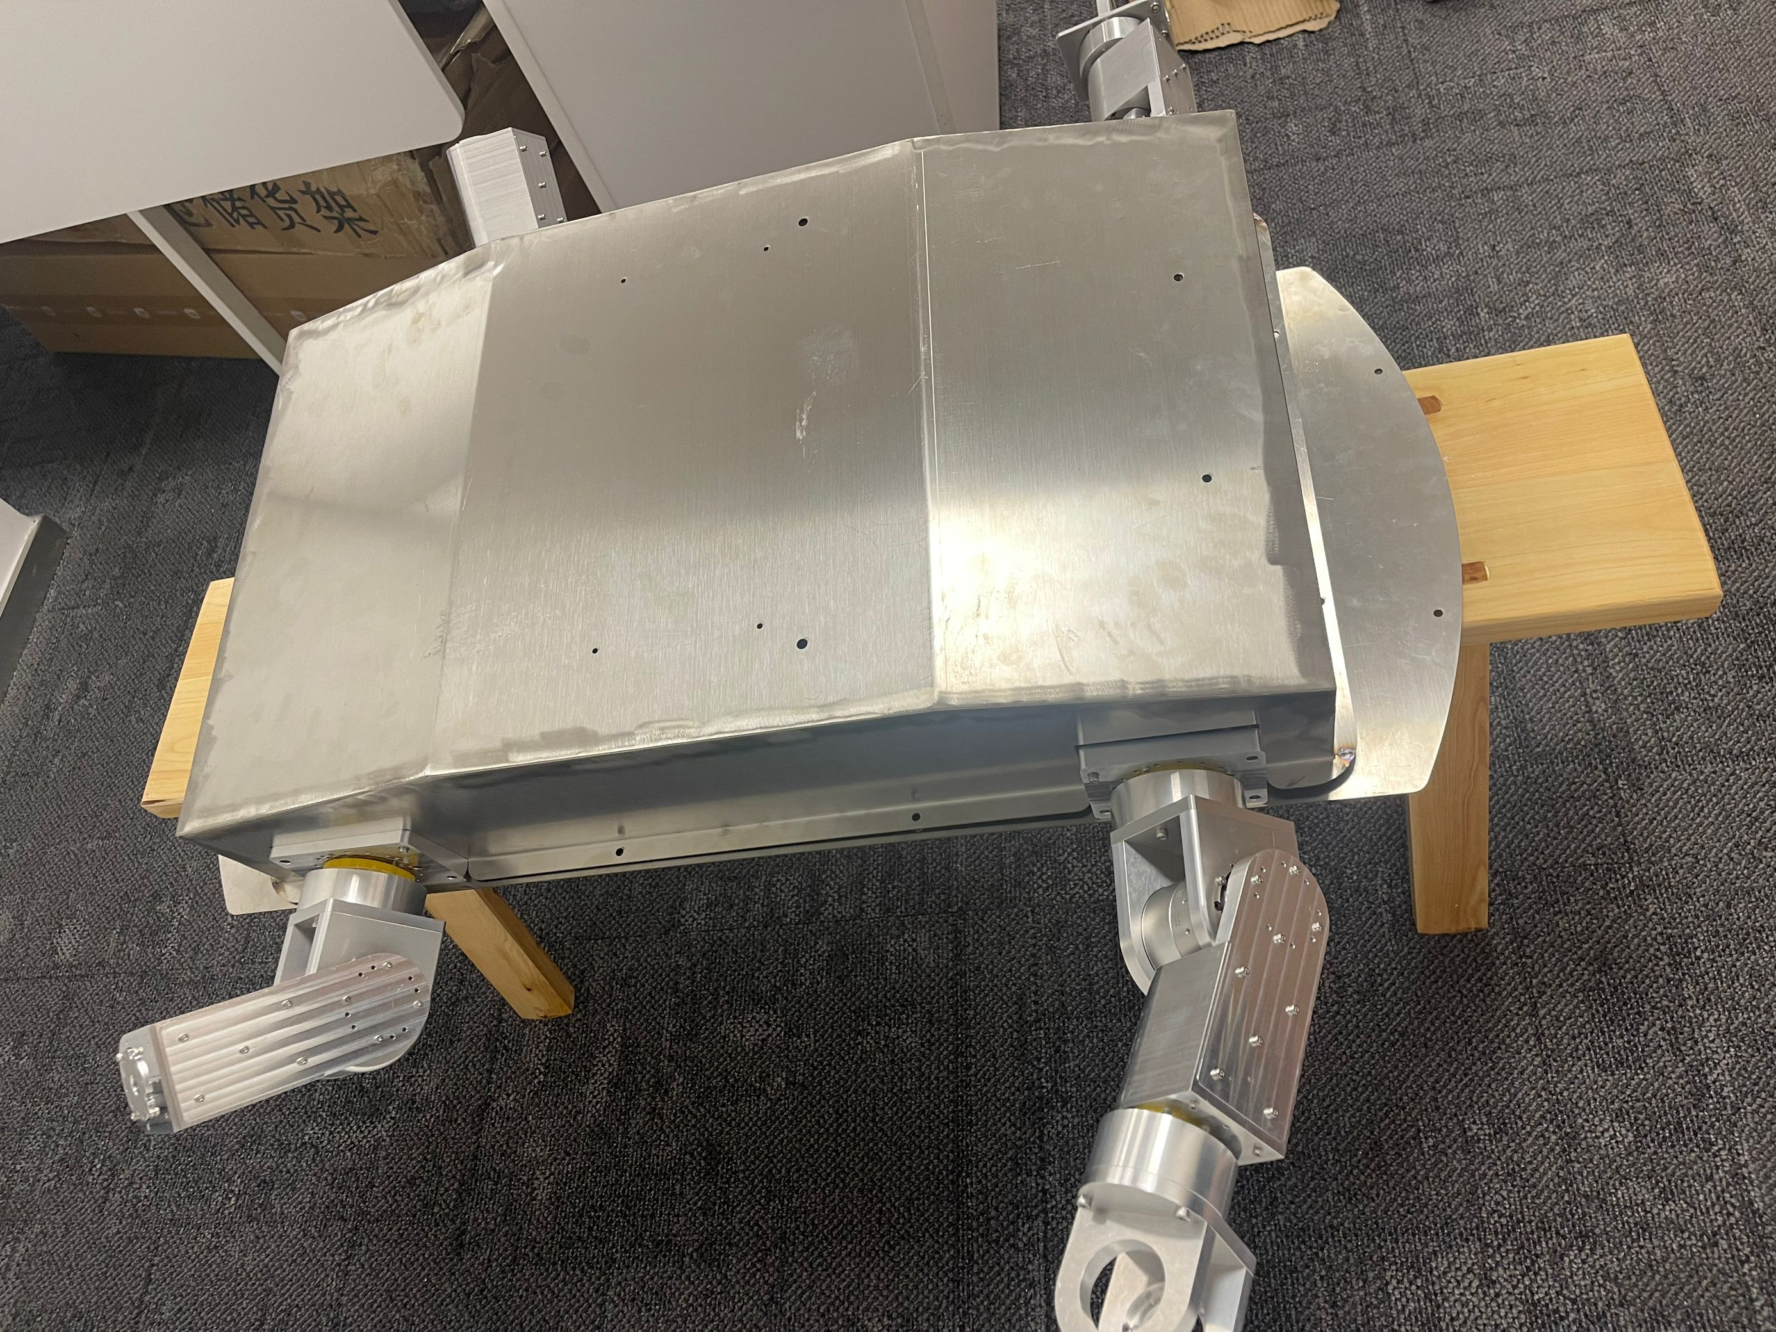
Cavity
Cavity Making
The first version of the test Cavity is made of stainless steel and is used to test the connection between the integrated parts.

Slide 2
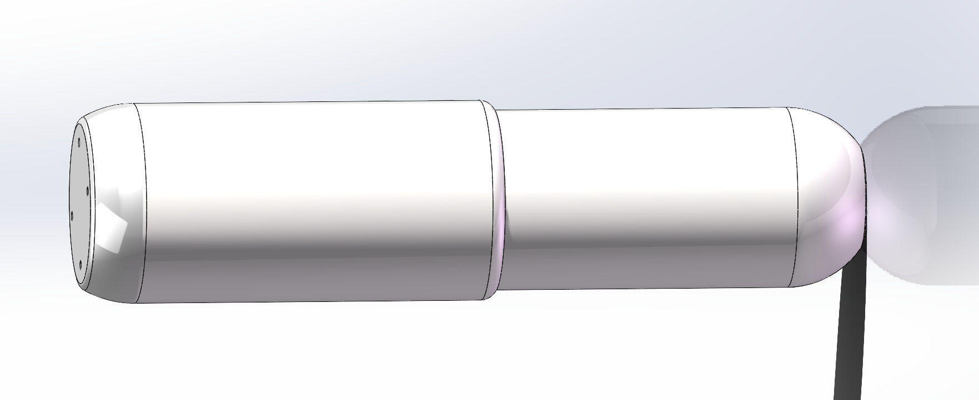
Cavity
Design of the piston
The physical model of piston is waiting in the queue to be printed(second version changed to rounded corners to reduce pressure).

Slide 3
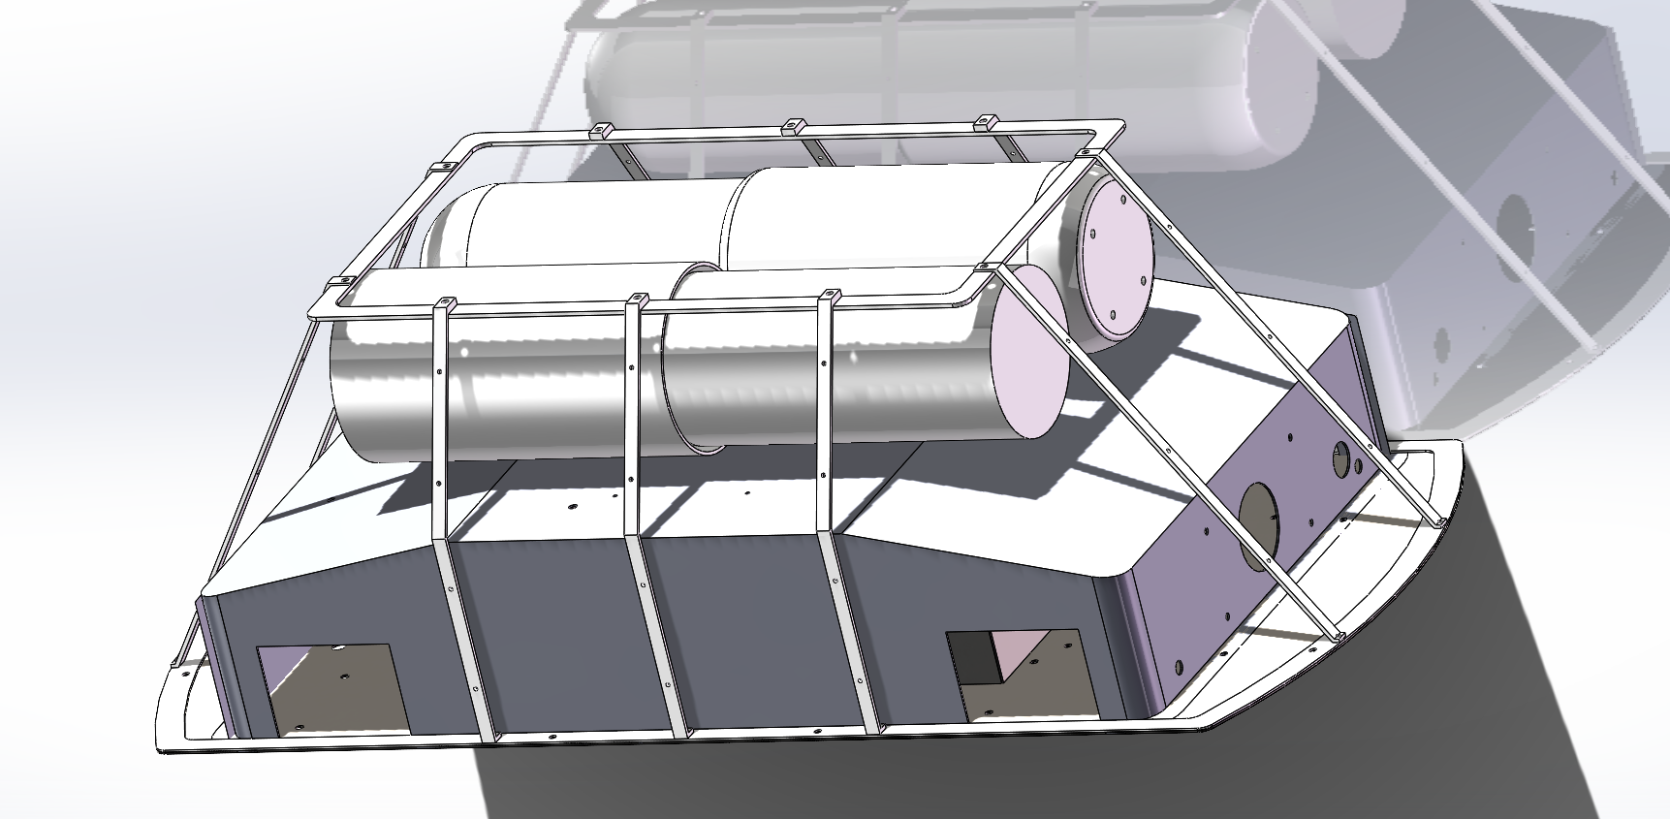
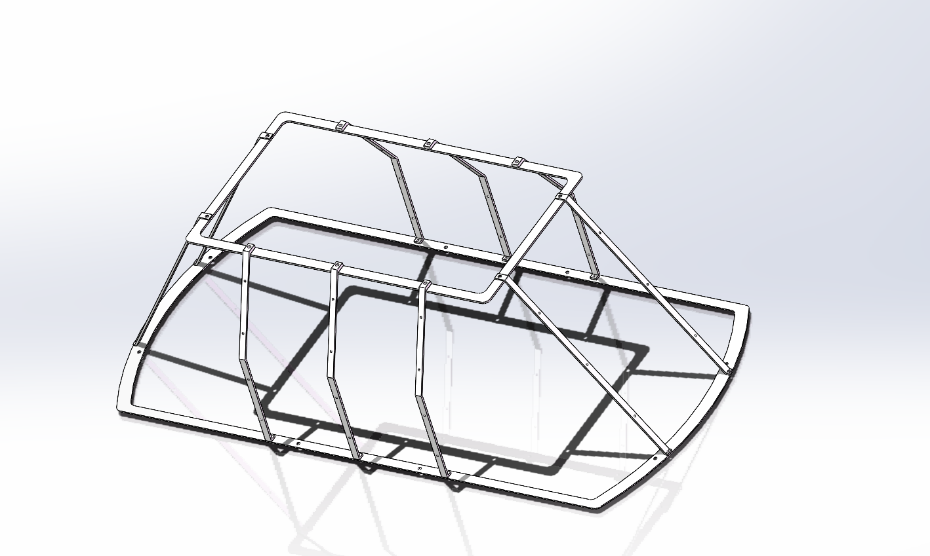
Cavity
Turtle Shell Making
The first version of the Turtle Shell design to add streamlining to the turtle has been completed and will be machined in a week!

